Slide 1
Electricity Production, Use and Price Analysis
Factors influencing Alberta’s Spot Market Electricity Prices, Grid Load and Production Mix
Daniela Mañozca Cruz
Gautham Nagaraj
Jeremy Reid
Joao Ricardo Bertti Targino

Slide 2
Introduction
Alberta established a deregulated electricity market in 1996 with the Electric Utilities Act (EUA), creating the possibility for private companies to compete for customers
The AESO also collects and evaluates industry public data and will be the primary data source for this project
The Balancing Pool administers a wholesale electricity market or ‘spot market’.
The Power Pool matches the lowest-priced supply with demand by establishing a pool price that is revised hourly

Slide 3
Background
The market has multiple private providers such as ENMAX, ATCO, ENCOR and Direct Energy
Companies have the option of generating their power or buying short-term contracts on the spot market, or a mix of both.
The power supplied to the spot market is primarily generated by private or public entities.

Slide 4
Objective
Study the relationship between a group of variables and spot prices based on different factors such as weather, population growth, type of generation and demand.
Develop a time-series model that can predict with certain confidence the spot price for next hours.
Understand the different energy sources and the amount of electricity generated from each of these sources

Slide 5
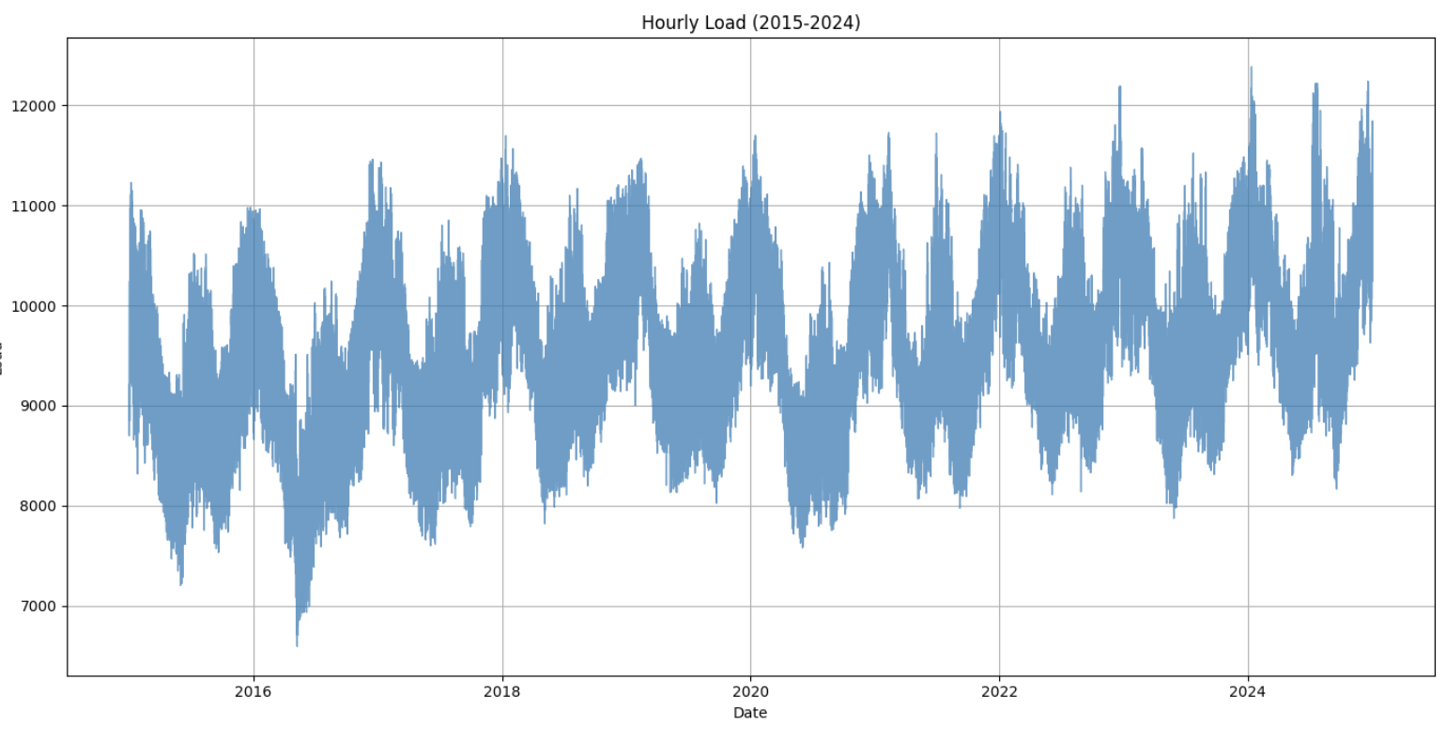
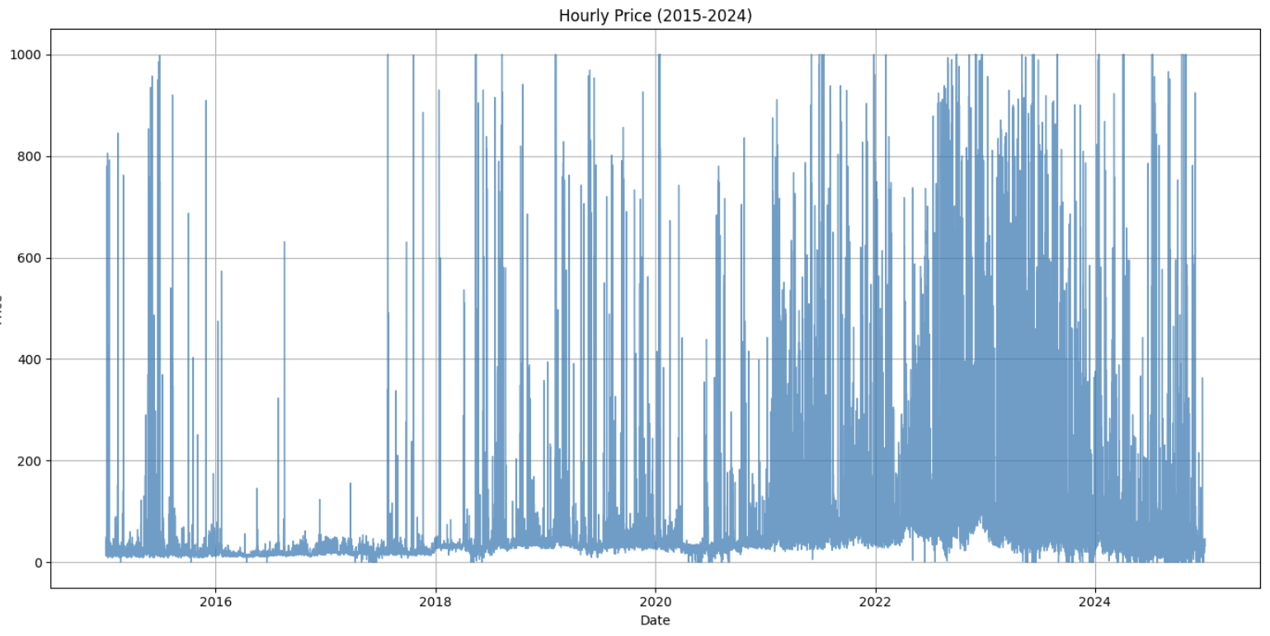
System Load and Electricity Price
Statistical checks are important to understand time series date prior to modelling:
Identifying outliers
Checking stationarity and heteroskedasticity (constant mean /variance)
Seasonality detection
Assessing autocorrelation
Allows modelling adjustments to be made

Slide 6
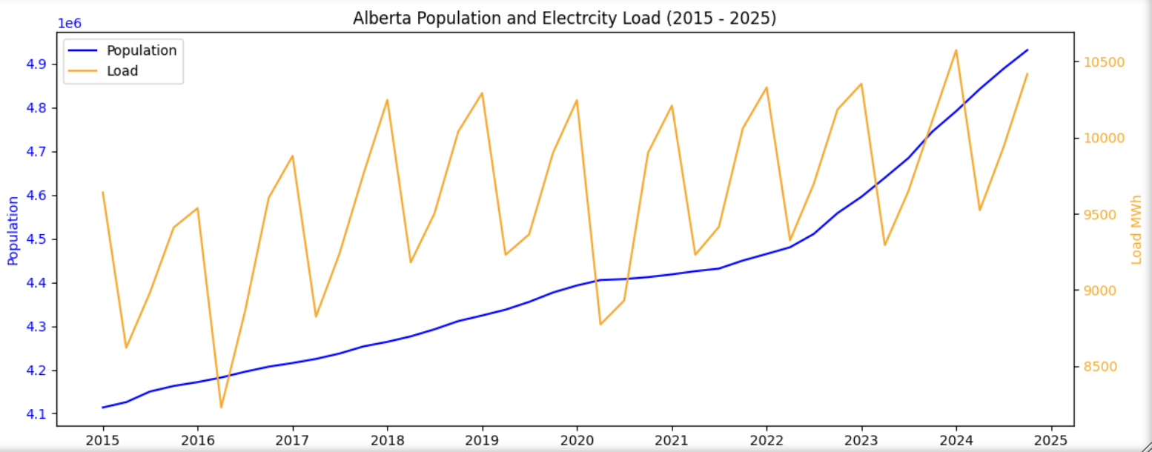
System Load and Population Data
Population is a primary driver of electrical grid load
This makes it an important independent variable to explore in understanding electricity demand
We are exploring this relationship in order to determine other factors important in predicting load
Prediction of price will require a complex model
Findings to date:
-Load data shows non-stationarity over annual periods, clear seasonality and autocorrelation with a primary and secondary seasonal pattern.
-Electricity price data show non-stationarity over 30, 90, and 365 days with clear seasonality, heteroskedasticity, non-uniform residuals and clear autocorrelation (yesterday’s price impacts today’s).
-Relationship between population and load appears to be non-linear.

Slide 7
Insights gained from each dataset
Temperature data: this dataset when joined with the generation data gives us some insights on what the generation value is based on the temperature
We can combine 2 datasets using an inner join based on the date/hour column
Ordering the results by temperature, we can see which days have the highest electricity generated compared to the lowest temperatures
We are expected to see a rise in electricity generated when the temperatures increase, as air-conditioners and humidifiers are turned on.

Slide 8
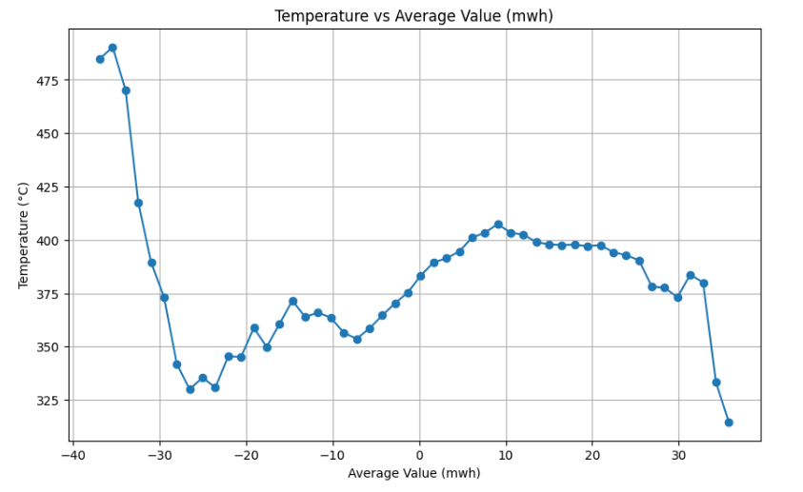
Temperature vs Generation (MWh)
This indicates that the relationship is not linear
If we were to build a regression model, we would need to look at non-linear models or exclude the temperature variable due to non-linearity

Slide 9
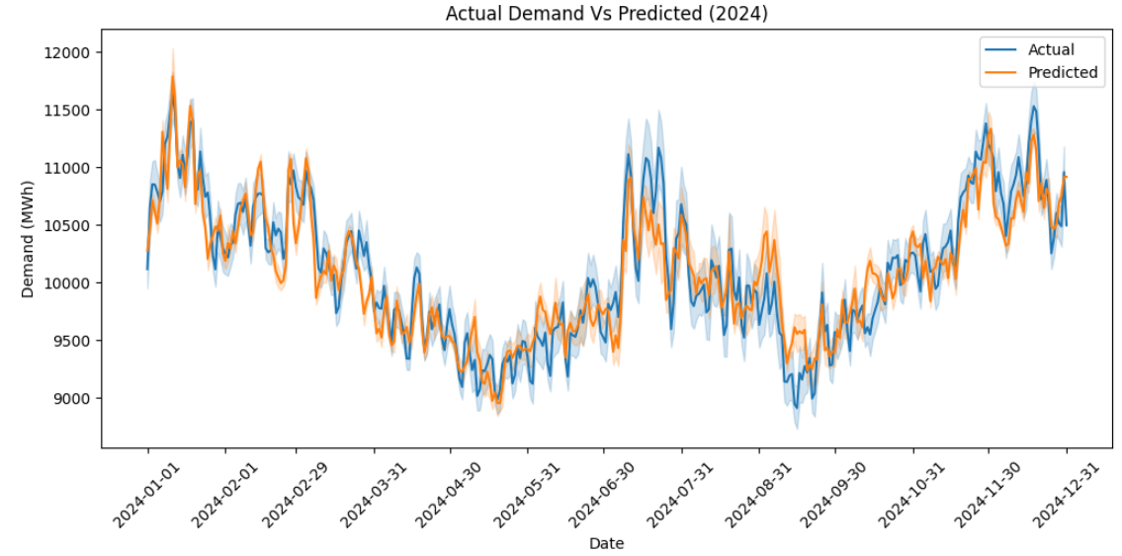
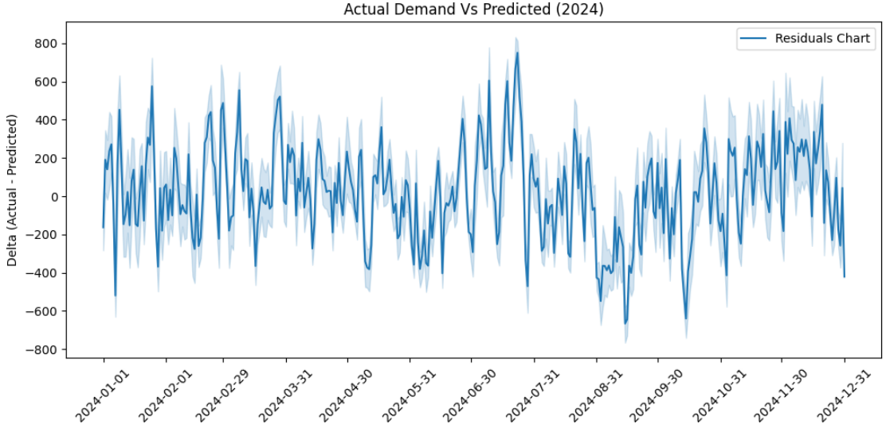
Statistical Modelling (On Course)
Demand Prediction: After combining all the datasets and adjusting with population growth, we could have a good prediction of the Demand –
We used Multi Linear Model and obtained an Adjusted R² of 0.699.

Slide 10
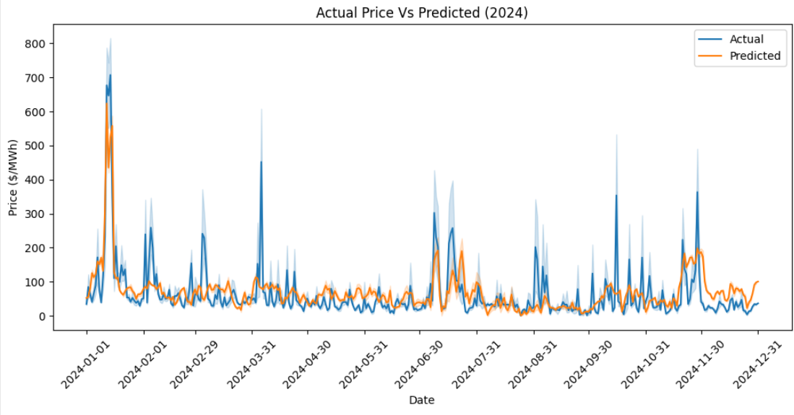
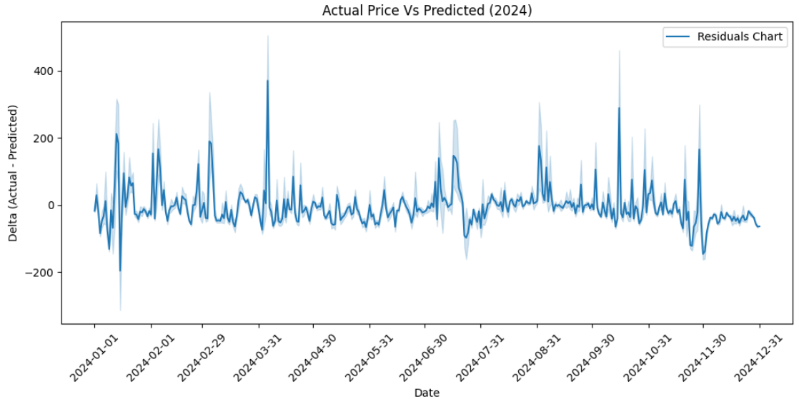
Next Steps
On the Modelling part, we are not only exploring different types of time-series models but also working towards having an improved Price model.
The first iteration (pre population adjustment) presented an Adjusted R2 of 0.2 but with high Residuals

Slide 11
Datasets
Several datasets and data points can be used to perform this analysis. To keep it simple and rely only on publicly available information, we decided to use these 6:
Demand (Load)
in MWh
Alberta’s internal load/Demand consisting of the total hourly demand in MW for the entire Province.
Temperature
Hourly temperature in Calgary (average of 3 stations) that will serve as an input for Demand prediction.
Gas Price
Since Natural Gas is the main source for 70% of the generation, the gas price will play a key part in projecting this.
Generation
Generation data will not only serve as an input for the type (green/non-green), but also for the delta between demand and generation that can cascade into price
Population
Growth
Alberta’s population is one of the fastest growing in Canada. As Electricity is an essential service, we will use this growth to adjust some of our curves and metrics.

Slide 12
What are the different energy generation sources?
Generation sources include natural gas plants (simple, combined or cogeneration cycles), wind farms, solar farms, among others.
Over the past years, green sources such as Wind and Solar have been gaining momentum, but Cogeneration still owns the largest share.
Natural Gas plants are responsible for almost ¾ of total generation.
Coal was rapidly phased out (from 32% in 2015 to 2% in 2024)

Slide 13
The Datasets
Gas Price
Temperature
Generation
Price
Demand
Population

Slide 14
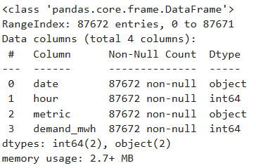

There are total of 5 datasets: Demand, temperature, gas price, generation and price.
Demand Dataset - The demand datasets consists of Alberta’s internal load/Demand consisting of the total hourly demand in MW for the entire Province combined with spot price and gas price
Visualizing the demand vs price, we can obtain an understanding of how an increase population increases the price

Slide 15
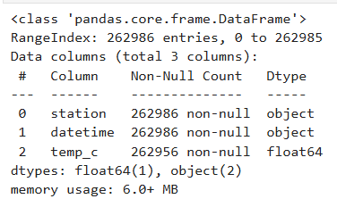

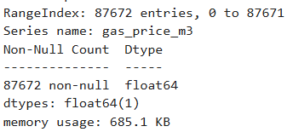

2. Temperature dataset – The temperature
dataset consists of the electricity generated vs
the temperature
We can obtain an understanding of how the
rise/fall in temperature increases the
electricity generated/demand
3. Gas Price – Cogeneration has been the source
with the highest electricity generated
Gas price will place an important role in predicting
the spot price , due to cogeneration

Slide 16
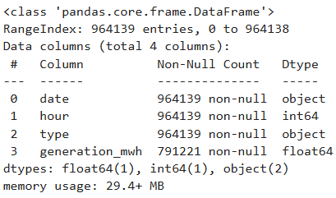

4. Generation – The generation
of electricity will play a role in
determining the spot price
There is a strong correlation
between the demand and the
generation
We can understand the impact
of the price by visualizing the
generation vs price data

